Slide 1

Introduction to Jenkins

Slide 2
Agenda
Introduction
Install Jenkins
Run Jenkins Job
Git, Github
MSBuild, Nuget
Nunit Unit Tests
MSTest Unit Tests
MSBuild Warnings
Pipeline

Slide 3
Introduction
What is Continuous Integration?
The practice of merging all developer working copies to a shared machine.
Why Continuous Integration?
Detect bugs as early as possible

Slide 4
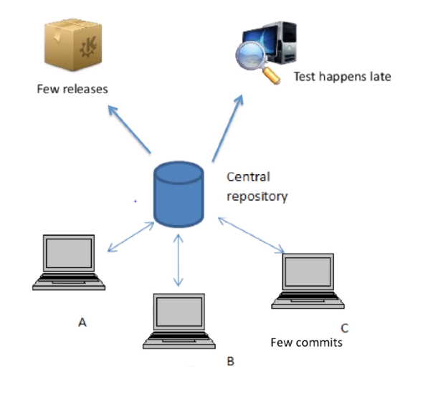
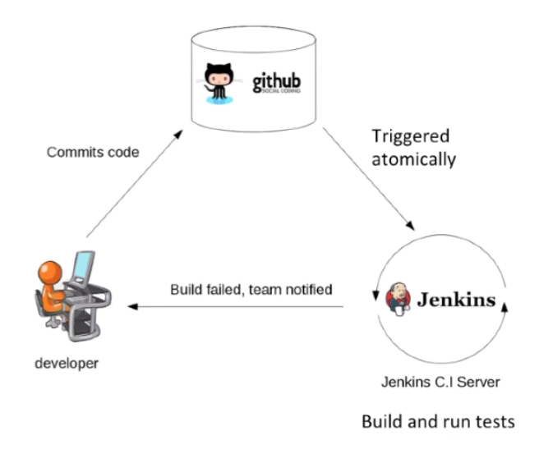
Introduction

Slide 5

Some other CI servers
CircleCI
TravisCI

Slide 6

The History of Jenkins
Hudson was started in 2004 by Kohsuke Kawaguchi as a hobby project.
First release in 2005
Became the leading Continuous Integration Solution in 2010
Renamed to Jenkins in 2011

Slide 7
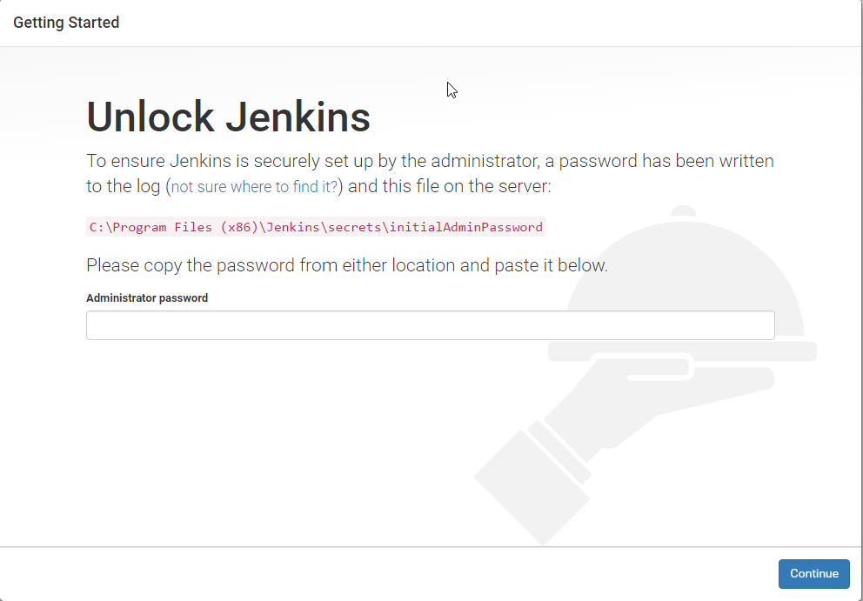
Install Jenkins
Go to https://jenkins.io/ and download Jenkins
Install Jenkins, then go to http://localhost:8080
Follow the instruction to login

Slide 8
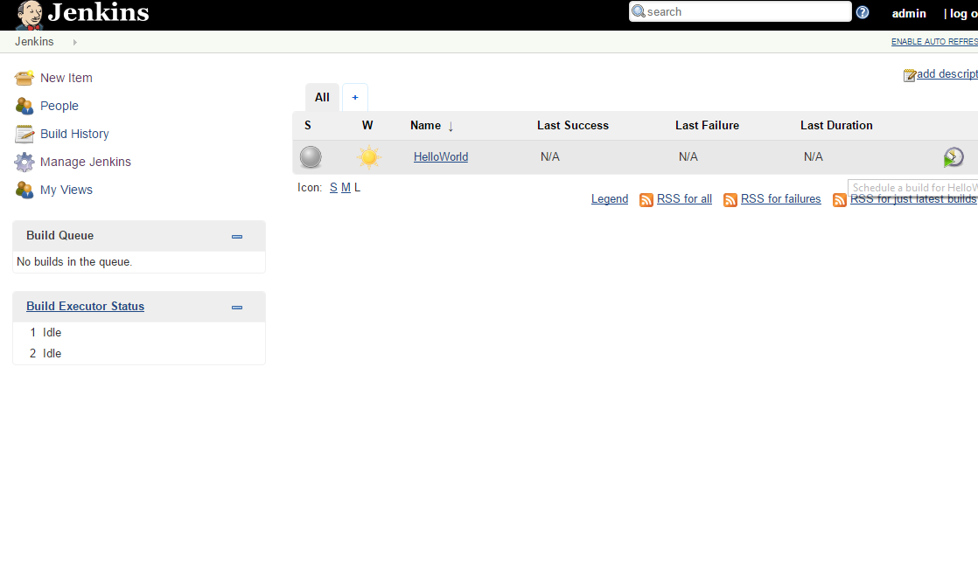
Run Jenkins Job

Slide 9
Practices
Git, Github
MSBuild, Nuget
Nunit Unit Tests
MSTest Unit Tests
MSBuild Warnings
Pipeline

Slide 10


Slide 11
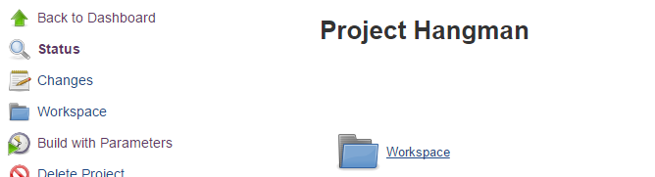
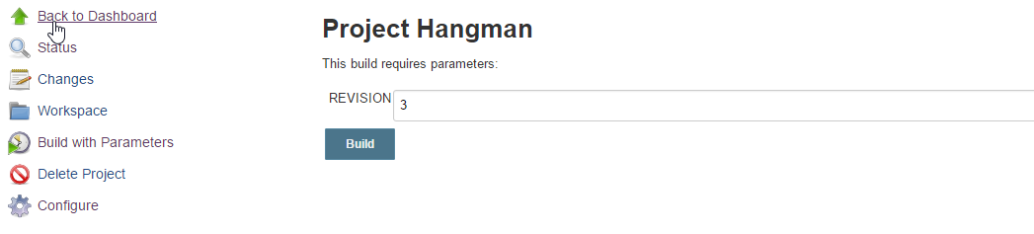
Final Practice
Build this C# project
https://subversion.assembla.com/svn/hangmanc-/trunk
Prompt the user for a revision number to build
Plugin: Global Variable String Parameter

